Slide 1
Evaluation study on the application of the principle of equality of opportunity between women and men and of the principle of equality of opportunity and non-discrimination, including accessibility for persons with disabilities, within Cohesion Policy 2014-2020 and on the assessment of implementation of the Governmental Programme - Accessibility Plus 2018-2025 MODULE II – Effects of implementation of the Accessibility Plus Programme

Slide 2
Objective of the study
Module I
Assessment of the principle of equality of opportunity between women and men
Assessment of equality of opportunity and non-discrimination
The study has been divided into 2 research modules
Module II has focused on the assessment of management system and effects of the Governmental Programme – Accessibility Plus.
Module II
Assessment of the Governmental Programme- Accessibility Plus

Slide 3
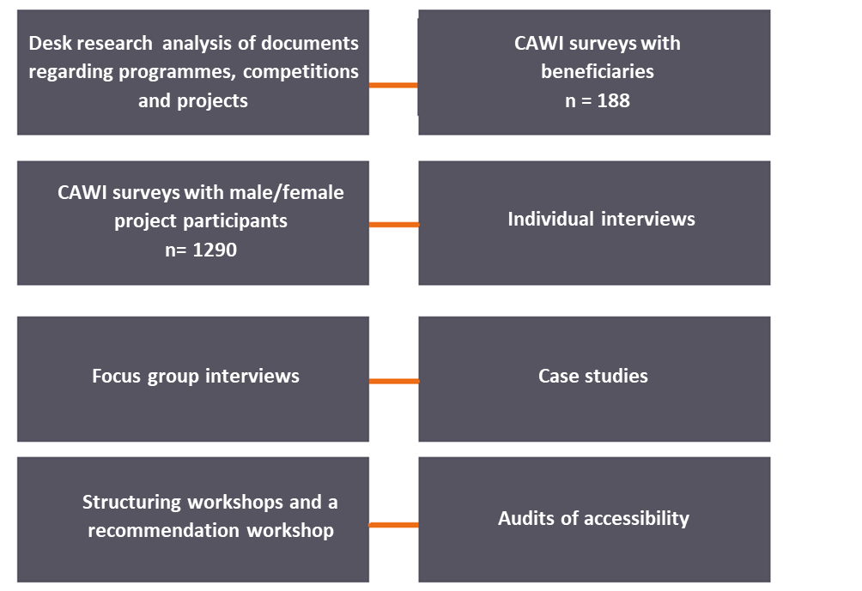
Methodology
Theory-based evaluation as a core approach.
To achieve the objective of the study, its specific form has been used – the so-called contribution analysis.
The following have been used in the study →

Slide 4
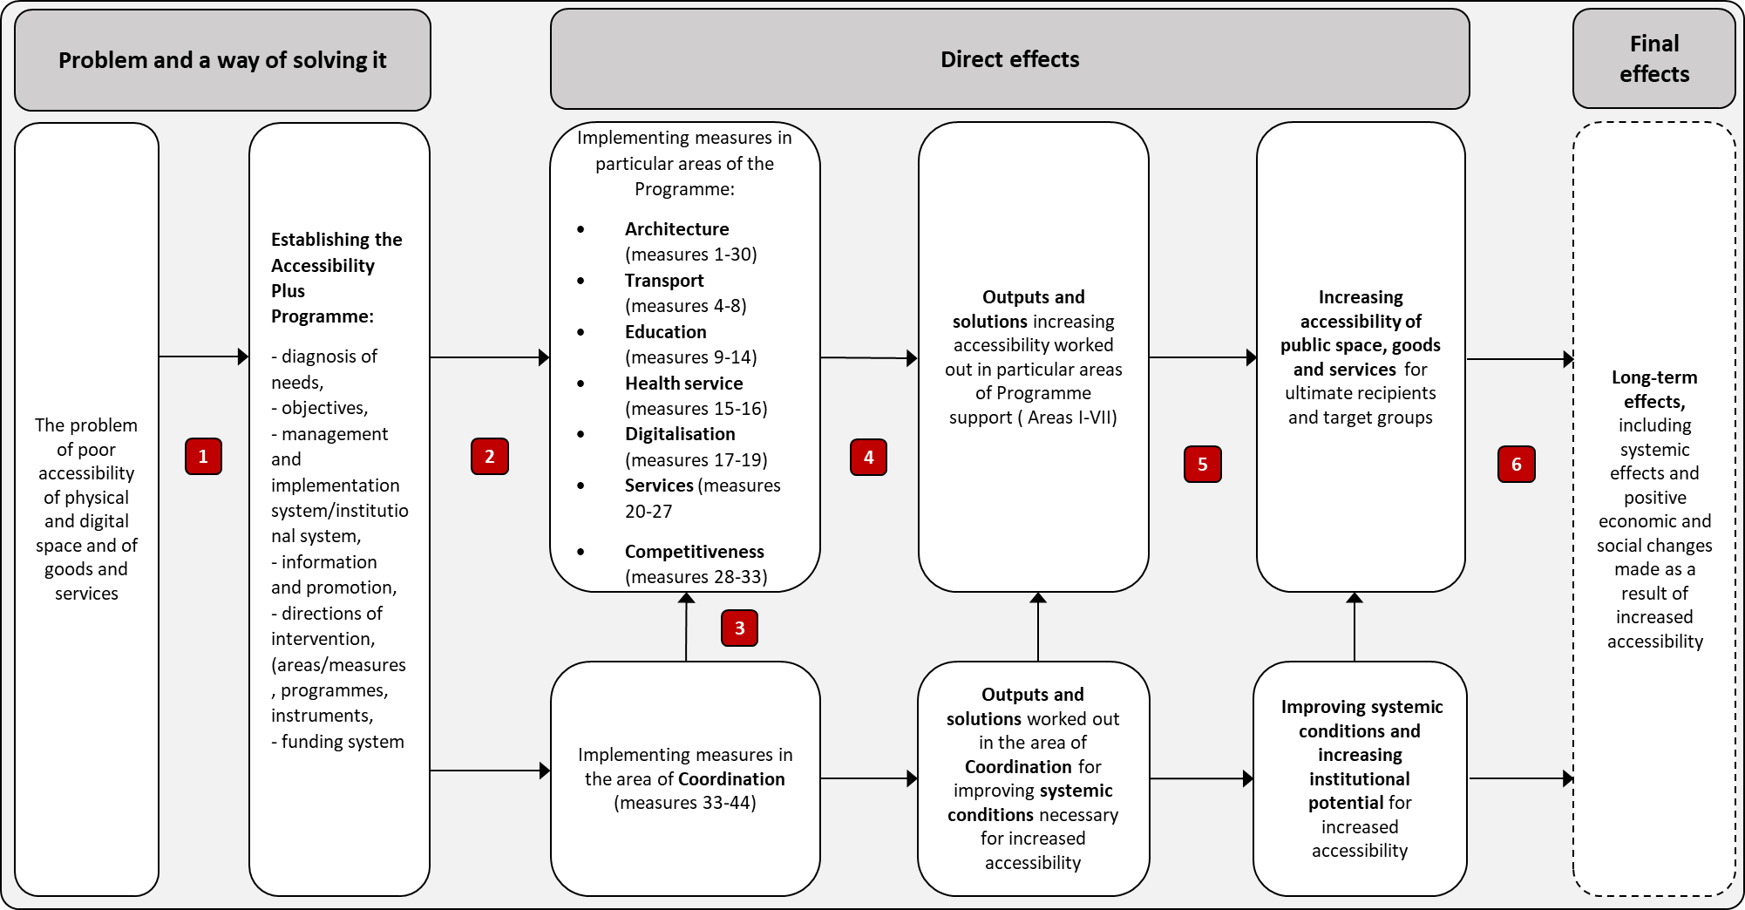
Intervention theory – Accesibility Plus Programme

Slide 5
Overall assessment of the Accessibility Plus Programme (1)
From the 3-year perspective the effects of the Programme implementation should be assessed positively.
It was a fast and efficiently prepared response to an urgent social need related to providing improved accessibility of space and public services for persons with disabilities.
One of key effects of the Accessibility Plus Programme is including the question of accessibility in public debate.
The implementation of some legislative amendments, planned within the Accessibility Plus Programme - which build up in a particular way a stable infrastructure and a basis for implementing accessibility in a long-term perspective-could be regarded as its greatest achievement of the Programme.

Slide 6
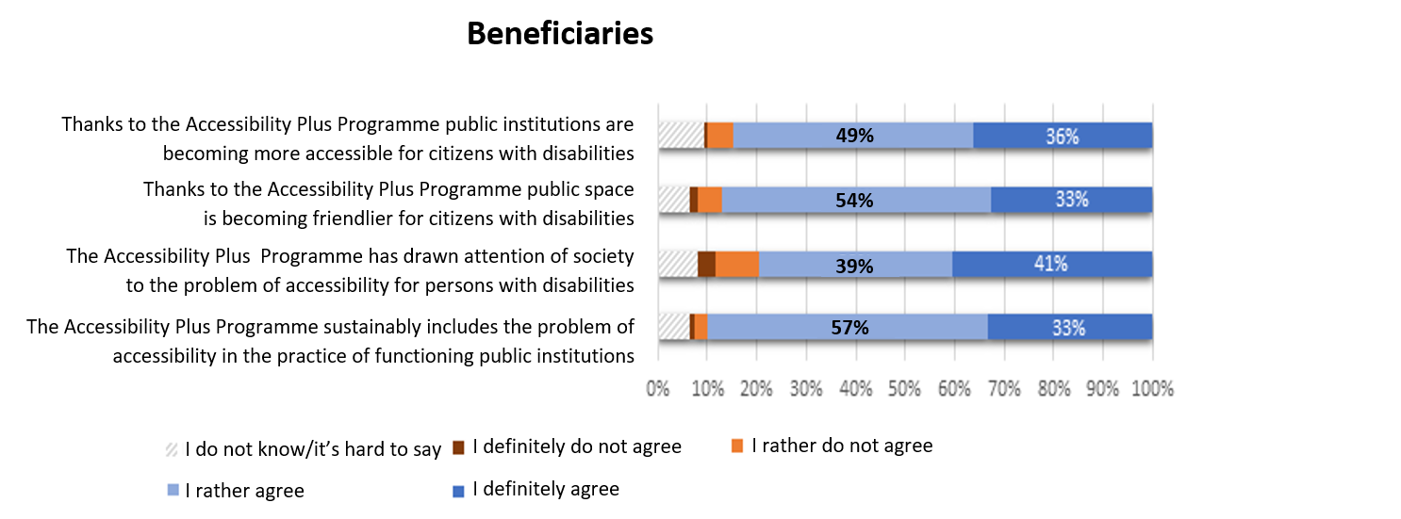
Overall assessment of the Accessibility Plus Programme (2)
Below you can find the statements which – to a different extent - refer to the Accessibility Plus Programme. Please tick to what extent you agree or do not agree with each of them
All female/male participants of this study have agreed that thanks to the Accessibility Plus Programme the issues related to accessibility have taken top positions on political and programming agendas of institutions and organisations
CAWI with benficiaries, n=138

Slide 7
Overall assessment of the Accessibility Plus Programme (3)
Were the following additional effects related to functioning your institution as a project promoter observed in the course of project implementation? - beneficiaries
Clearly visible effects have been also observed at the level of changes in awareness in both institutions engaged in the Programme implementation and beneficiaries as well as in ultimate support recipients… →
Source: CAWI with beneficiaries, n=146

Slide 8
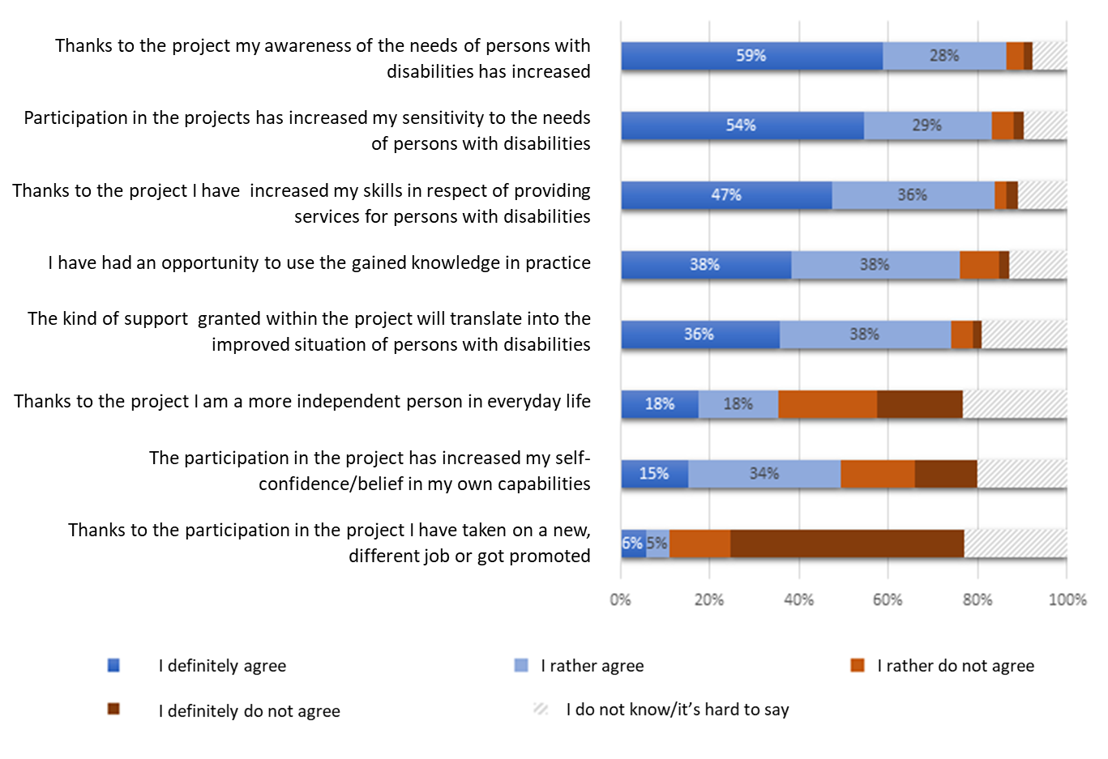
Overall assessment of the Accessibility Plus Programme (4)
Below you can find the statements which – to a different extent -refer to your participation in the project. Please tick to what extent you agree or do not agree with each of them - participants
… and also in ultimate recipients of the support. →
The analysed projects have had the biggest impact on an increase in awareness of the needs of persons with disabilities – as much as 59% of male/female participants definitely agree with such a statement.
Also male/female participants who are persons with disabilities most frequently indicate this effect as the most significant to them (55% of male/female participants being persons with disabilities definitely agree with this statement).
CAWI with participants, n=1290

Slide 9
Overall assessment of the Accessibility Plus Programme (5)
Key challenges conditioning effective implementation of the Programme:
Lack of a multiannual and stable budget (it concerns part of activities funded from national resources).
Restrictions resulting from the effects of the COVID-19 pandemic issued over 2020-2021 have been a significant hindrance for performed activities.
Immense scale of needs (particularly it concerns undertaking infrastructural activities) and an insufficient financial allocation to these objectives – the problem is additionally deepened by the increase in prices of goods and services directly related to accessibility.
Insufficient number of experts with appropriate knowledge and competence regarding the problem of accessibility in a broader sense.

Slide 10
Architecture
The activities undertaken are oriented at an objective and are addressed relevantly.
Changes regarding the necessity of taking account of accessibility standards as early as at the stage of designing newly-erected buildings should be regarded as the most important ones in this area.
It is a revolutionary change, which will have the biggest impact on the accessibility of a built environment in a long term ( along with changes introduced into the mode of educating architects).
Unfortunately, the scale of needs in this area is much larger than implementational and financial capacities planned in the Accessibility Plus Programme.

Slide 11
Transport
The implementation of a considerable part of the tasks planned in this area has been started.
The main hindrances have appeared in implementing a training project targeted at transport employees and in delivering COMBO carriages.
As compared to other areas of the Accessibility Plus Programme, an important facility in the area of transport is the TSI PRM (Commission Regulation (EC) regarding accessibility of vehicles and railway infrastructure). Well-founded and unambiguously-defined standards in the area of railway infrastructure facilitate undertaking many activities related to providing accessibility.

Slide 12
Education
As for the area of education, it is worth paying particular attention to a visible change in the approach and awareness of needs typical of persons with disabilities.
The amendments introduced in the act regarding education law should be assessed positively.
Nonetheless, the scale and financial resources are definitely insufficient as for existing challenges.
At the same time it is necessary to clearly indicate financial risks related to project implementation, including, among others, the above mentioned increase in prices.

Slide 13
Health
Despite delays, resulting mostly from the COVID-19 pandemic, the main project implemented in this area – ‘Accessibility Plus for Health’ might contribute to a systemic change in healthcare in respect of its increased accessibility.
The biggest limitation of the project is its insignificant scale as compared to immense needs of the sector.
The complexity of ventures is also of great importance - combining infrastructural, digital, competence and organisational investments.
The planned continuation of the venture within the new financial perspective also deserves a positive assessment.

Slide 14
Digitalisation
A key element, which should translate into positive sustainable changes in a long term, is passing the ‘Act on digital accessibility of websites and mobile applications of public entities’.
The results of audits point at the first positive effects of the requirements introduced. A systematic improvement of accessibility of websites of public entities is still in progress.
As the main barriers for increased digital accessibility of public entities, it is possible to indicate an insufficient level of knowledge and experience in this respect, especially among smaller local government units, as well as a lack of financial resources for adjusting offices to the new requirements.
It should be stated that the initiatives of the Chancellery of the Prime Minister - taken in favour of substantive and technical support granted to public entities as for implementing solutions fostering their increased digital accessibility- should be assessed as particularly utile.

Slide 15
Services
A vast majority of the initiatives planned in this area is still at the preliminary stage.
An important effect of implementing activities undertaken in this part of the Programme is a change in approach, observed mainly among administrative employees at the central and local levels and in culture institutions.
Visible implementation risks concern mainly the sustainability of social services, which results from their project implementation system.
The biggest risks related to unimplemented assumptions have been observed in the activity referring to work in the administration (due to too small a scale of initiatives undertaken as compared to the ambitiously-defined objective).

Slide 16
Competitiveness
The initiatives undertaken could be assessed as relevant in view of the needs in the area of accessibility.
Interventions undertaken within the area result from coherent logic.
They take account of both direct support for projects aimed at working out innovative products addressing the needs of persons with disabilities and indirect support aimed at increasing knowledge and awareness of entrepreneurs and at building the innovation ecosystem in the area of accessibility.
In the context of generally low supply of projects within competitions dedicated to the problem of accessibility, it is necessary to continue and to expand the scope of activities aimed at increasing the capacity of enterprises for developing products which take account of the needs of persons with disabilities.

Slide 17
Coordination
An appropriate substantive preparation and a high- standard culture of cooperation of the unit responsible for coordinating the Programme - Ministry of Development Funds and Regional Policy should be regarded as one of the strongest cells in the area of coordination.
However, locating the Polish Access Board within the framework of a standard structure in one of the ministries weakens considerably its coordination position and limits real opportunities for exerting an impact on other entities.
The Access Board has been regarded as a systemically necessary entity.
Apart from the institutional aspect, it is necessary to positively assess legislative amendments implemented within the area under discussion as well as changes in awareness which have been made by among others, performing educational and informative activities.

Slide 18
Key recommendations
To update the objectives and scope of particular activities as well as implementation indicators with regard to the assumed effects of the Accessibility Plus Programme. In the course of the update it is necessary to analyse in detail the objectives which the Programme is to achieve in the context of limited resources for its implementation
To continue and to implement new initiatives for building up a potential of competent staff in both administration and other institutions ( universities, NGOs).
To improve the coordination of informative and promotional activities in respect of the Accessibility Plus Programme, including more intensive promotion of the Programme brand and undertaking activities disseminating knowledge of the complaint mechanism with regard to a lack of accessibility of public institutions.

Slide 19
Thank you for your attention!

